Slide 1
Team name: The Minority Group
Duo Xu: Lead Artist, Music Producer, Team Leader
Mahdi Judeh: Game/level Designer, Programmer
Sandeep Ingale: Lead Programmer
Guang Li: Programmer, Artist assistant
Wilson Zhu: Programmer, Sound producer

Slide 2
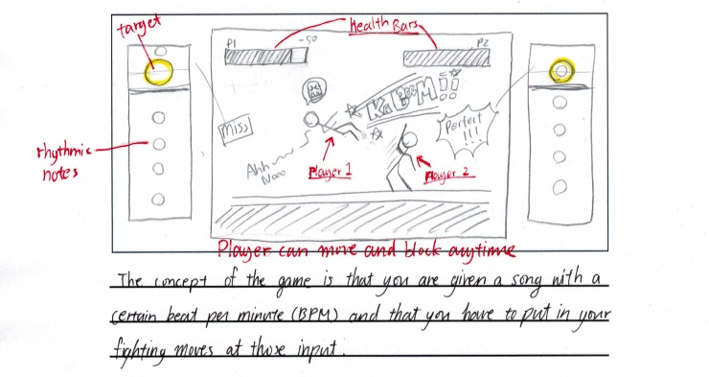

Slide 3
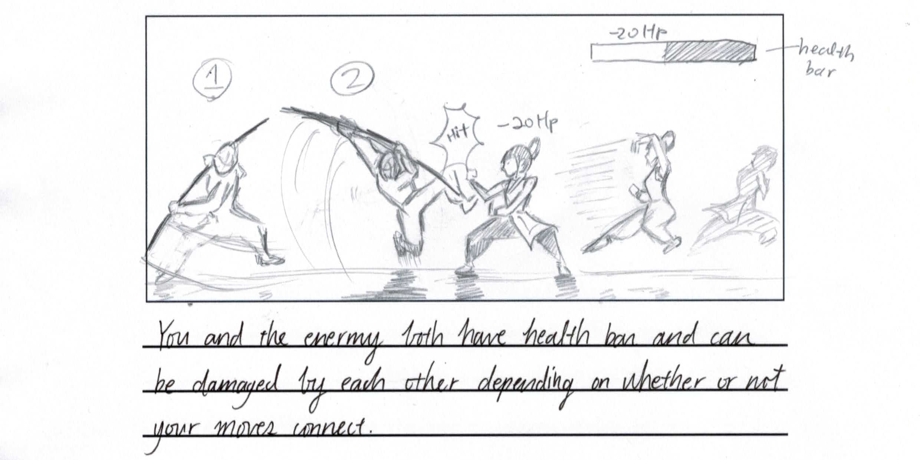

Slide 4
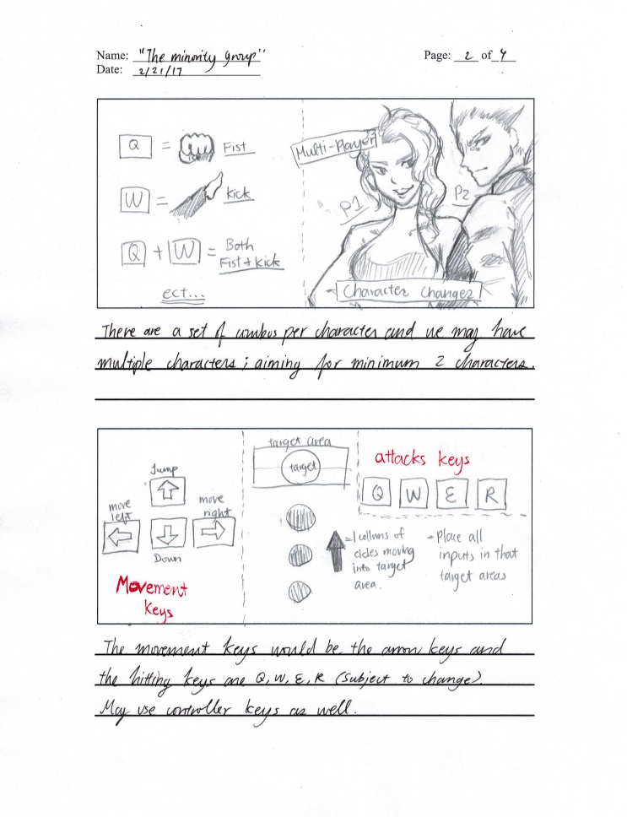

Slide 6
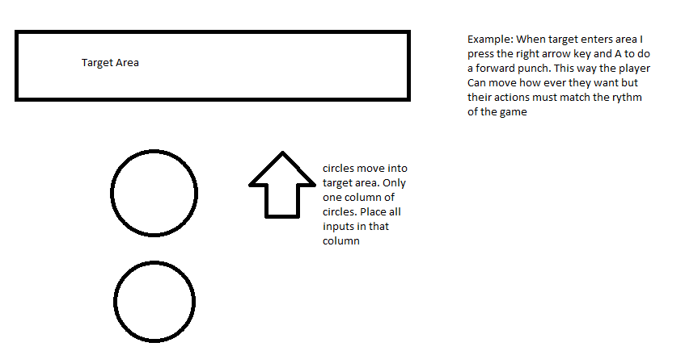

Slide 7
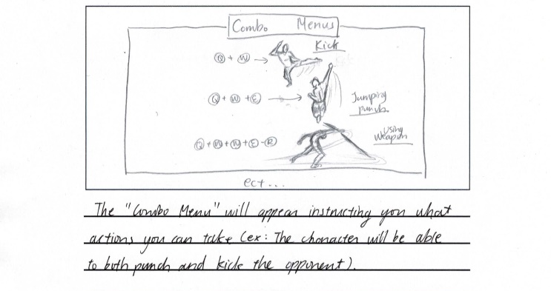

Slide 8


Slide 9
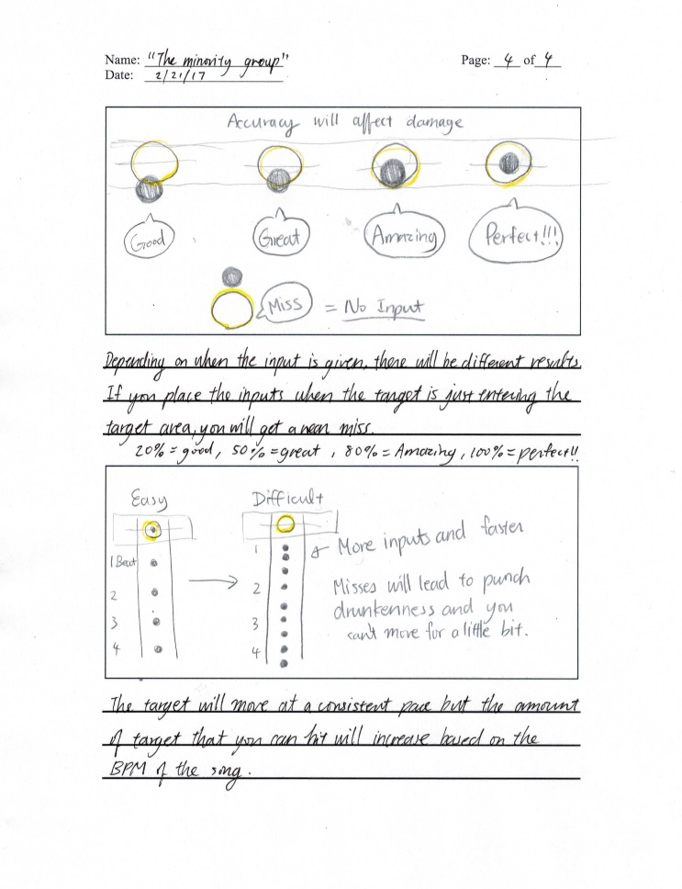

Slide 11
